Slide 1
This video was created by volunteers from the
Santa Fe Alliance for Science, a 501(c)(3) organization.
Our Mission
We inspire the inner scientist in Santa Fe students by creating STEM learning and discovery opportunities through our network of volunteer scientists, engineers, and other STEM professionals.
Learn more: www.sfafs.org
2020

Slide 2
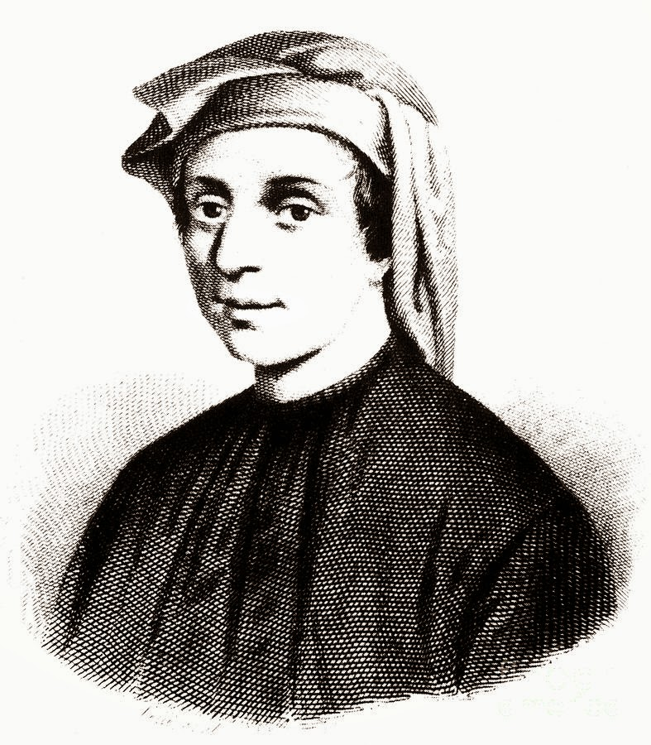
Fibonacci
and his numbers
Hubert van Hecke
January 2021

Slide 3
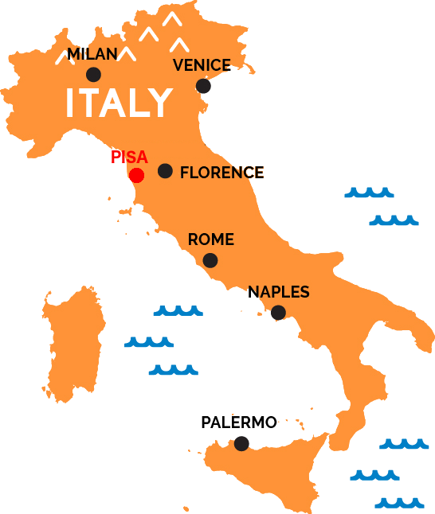
1170-1250
Leonardo of Pisa
Fibonacci
Son of Bonacci
1172-1372

Slide 4
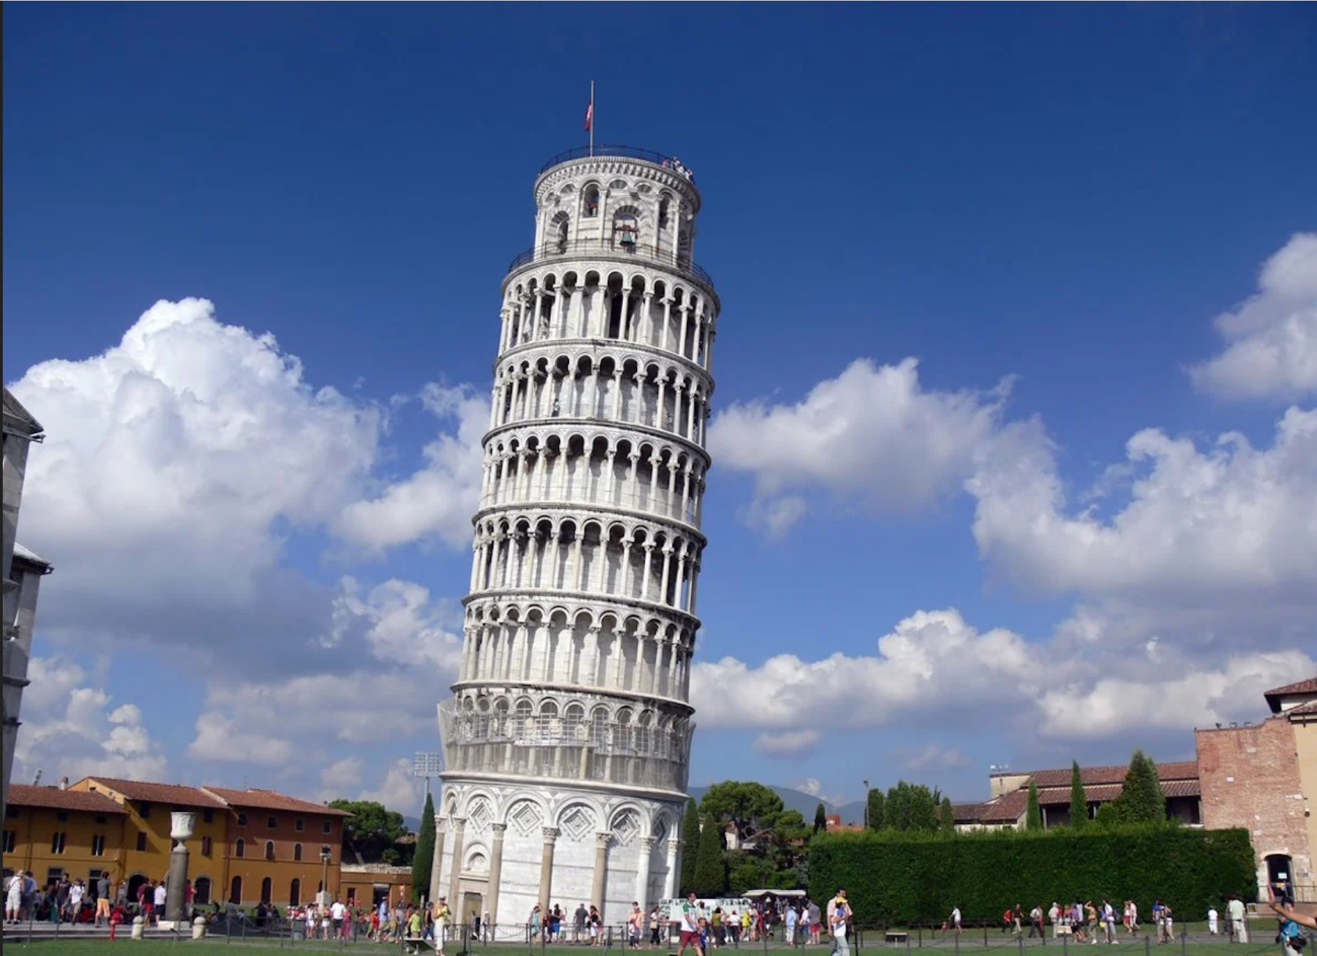
Leaning tower of Pisa

Slide 5
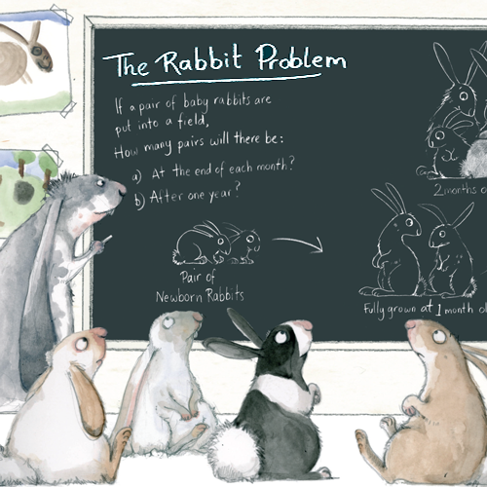
If I put a pair of baby rabbits in a field,
How many rabbits will there be in a year?
Rules:
It takes one month to grow into an adult rabbit
An adult pair will produce a pair of baby rabbits every month

Slide 6
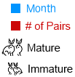

Slide 12
Fibonacci number series
1 1 2 3 5 8 13 21 34
??

Slide 13
Fibonacci number series
1 1 2 3 5 8 13 21 34
??

Slide 14
Fibonacci number series
1 1 2 3 5 8 13 21 34
??

Slide 15
Fibonacci number series
1 1 2 3 5 8 13 21 34
??

Slide 16
Fibonacci number series
1 1 2 3 5 8 13 21 34
??

Slide 17
Fibonacci number series
1 1 2 3 5 8 13 21 34
??
Every number is the sum of the previous two numbers

Slide 18
Fibonacci number series
1 1 2 3 5 8 13 21 34
??
Every number is the sum of the previous two numbers

Slide 19
Fibonacci number series
1 1 2 3 5 8 13 21 34
??
21
34
---- +
55
Every number is the sum of the previous two numbers

Slide 20
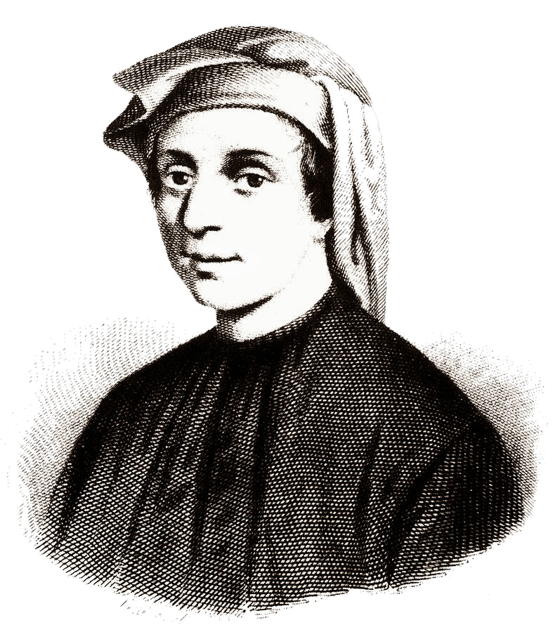
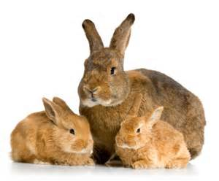
Fibonacci number series
Every number is the sum of the previous two numbers
1 1 2 3 5 8 13 21 34 _ _ _ _
1 January 1190
1 January 1191
1 July

Slide 21
Fibonacci number series
Every number is the sum of the previous two numbers
1 1 2 3 5 8 13 21 34 55 _ _ _
1 January 1190
1 January 1191
1 July

Slide 22
Fibonacci number series
Every number is the sum of the previous two numbers
1 1 2 3 5 8 13 21 34 55 89 _ _
1 January 1190
1 January 1191
1 July

Slide 23
Fibonacci number series
Every number is the sum of the previous two numbers
1 1 2 3 5 8 13 21 34 55 89 144 _
1 January 1190
1 January 1191
1 July

Slide 24
Fibonacci number series
Every number is the sum of the previous two numbers
1 1 2 3 5 8 13 21 34 55 89 144 233
1 January 1190
1 January 1191
1 July

Slide 25
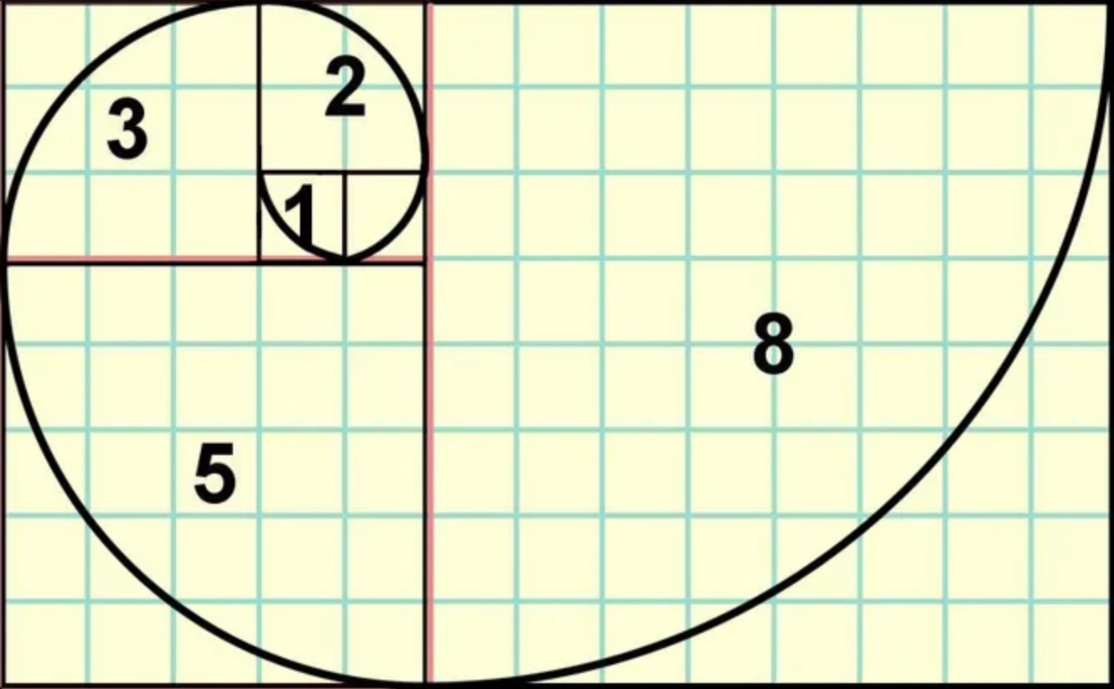
+

Slide 26
+

Slide 27
+

Slide 28
+

Slide 29
+

Slide 30
+

Slide 33
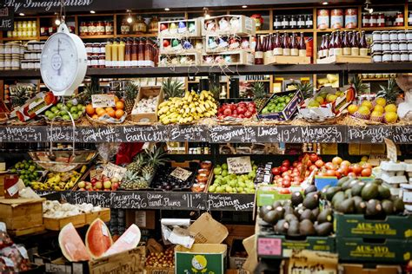
Let’s find Fibonacci numbers in Nature
First: the grocery store
1 1 2 3 5 8 13 21 34 55 . . .

Slide 34
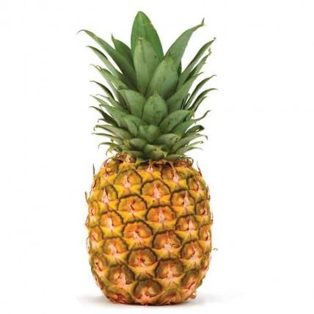
Fibonacci numbers in Nature
pineapple
1 1 2 3 5 8 13 21 34 55 . . .

Slide 35
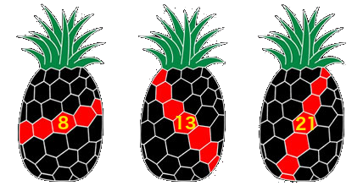
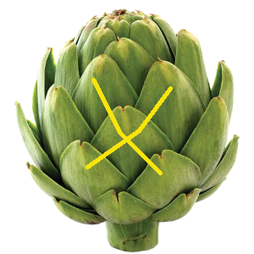
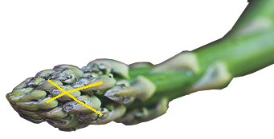
Pineapple
1 1 2 3 5 8 13 21 34 55 . . .
Artichoke
1 1 2 3 5 8 13 21 34 55 . . .
Asparagus
1 1 2 3 5 8 13 21 34 55 . . .

Slide 36
Pineapple
1 1 2 3 5 8 13 21 34 55 . . .
Artichoke
1 1 2 3 5 8 13 21 34 55 . . .
Asparagus
1 1 2 3 5 8 13 21 34 55 . . .

Slide 37
Pineapple
1 1 2 3 5 8 13 21 34 55 . . .
Artichoke
1 1 2 3 5 8 13 21 34 55 . . .
Asparagus
1 1 2 3 5 8 13 21 34 55 . . .

Slide 38
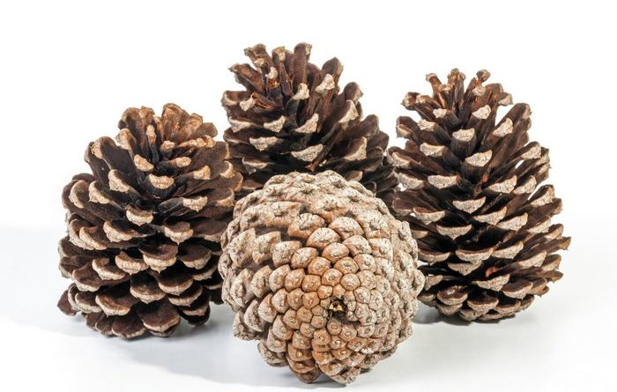
Fibonacci numbers in Nature
pinecones
1 1 2 3 5 8 13 21 34 55 . . .

Slide 39
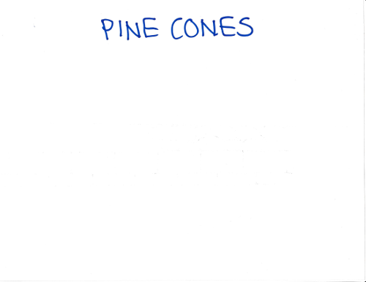
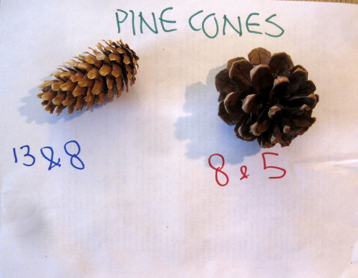
(switch to overhead camera)

Slide 40
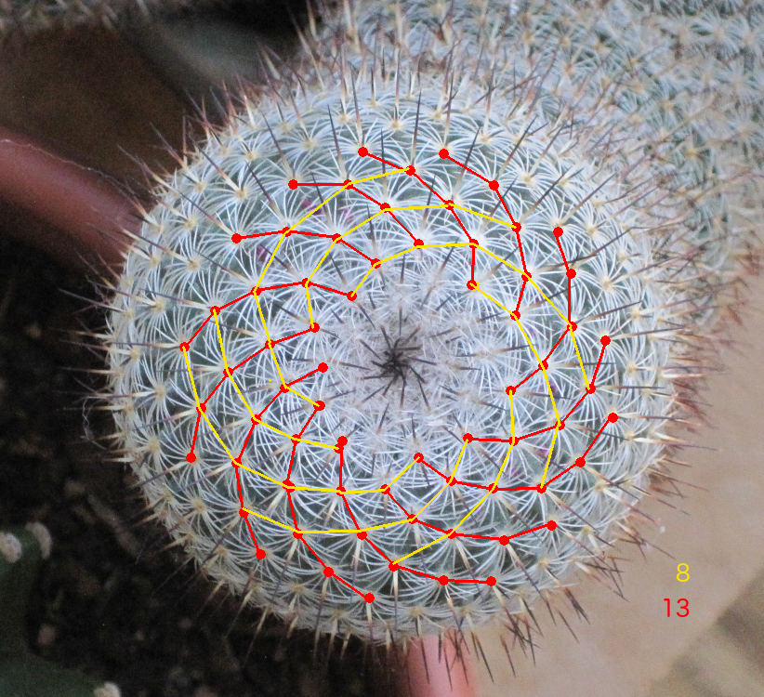
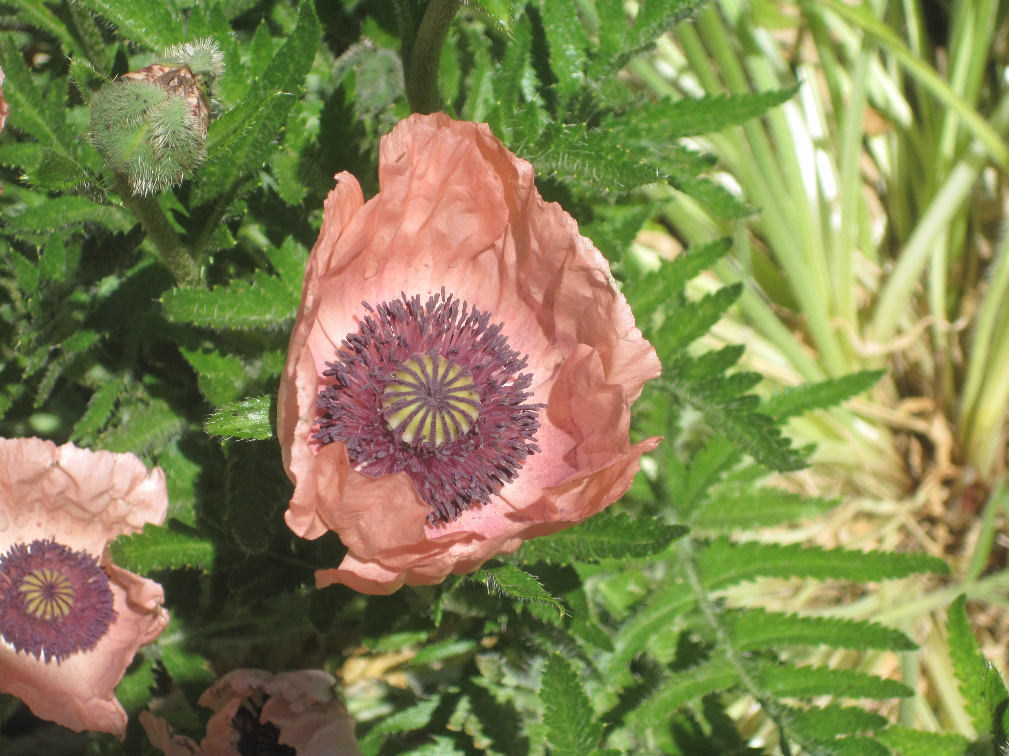
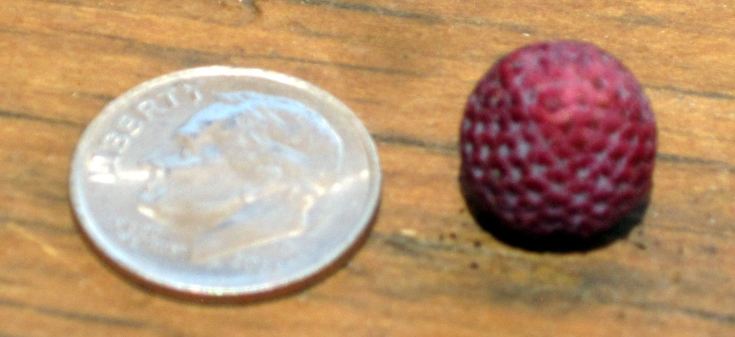
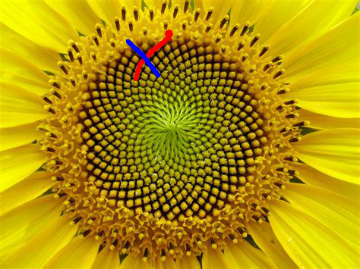
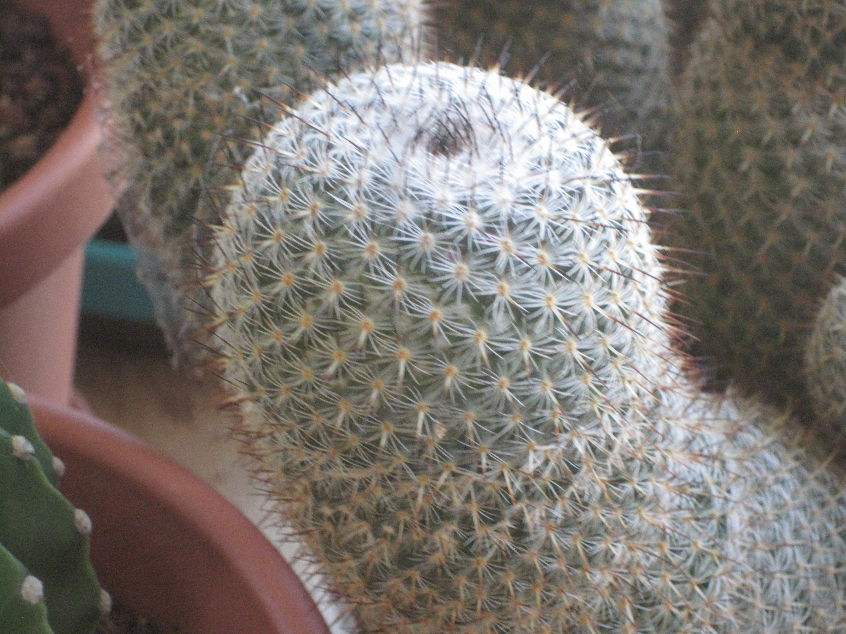
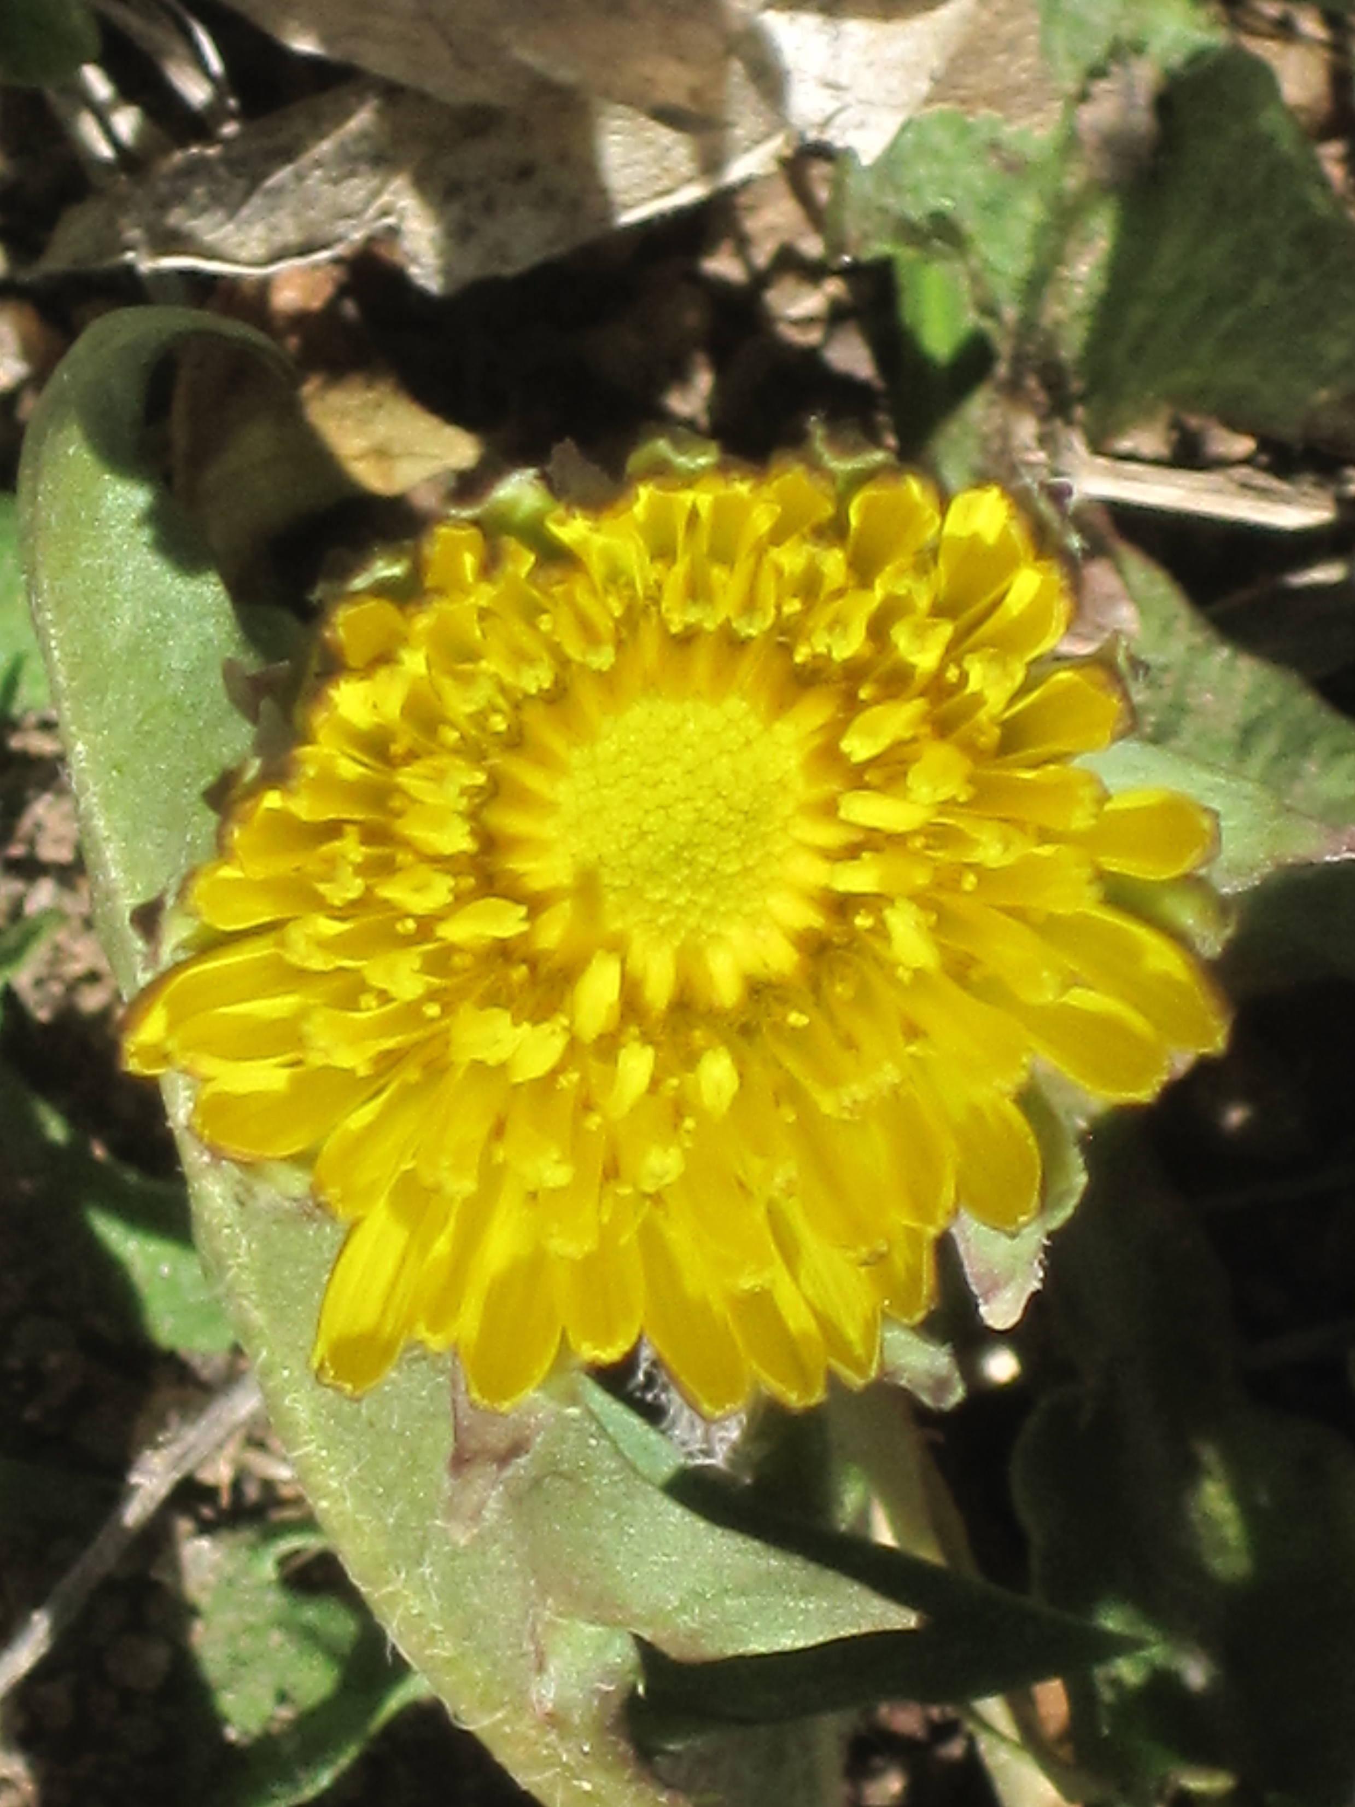
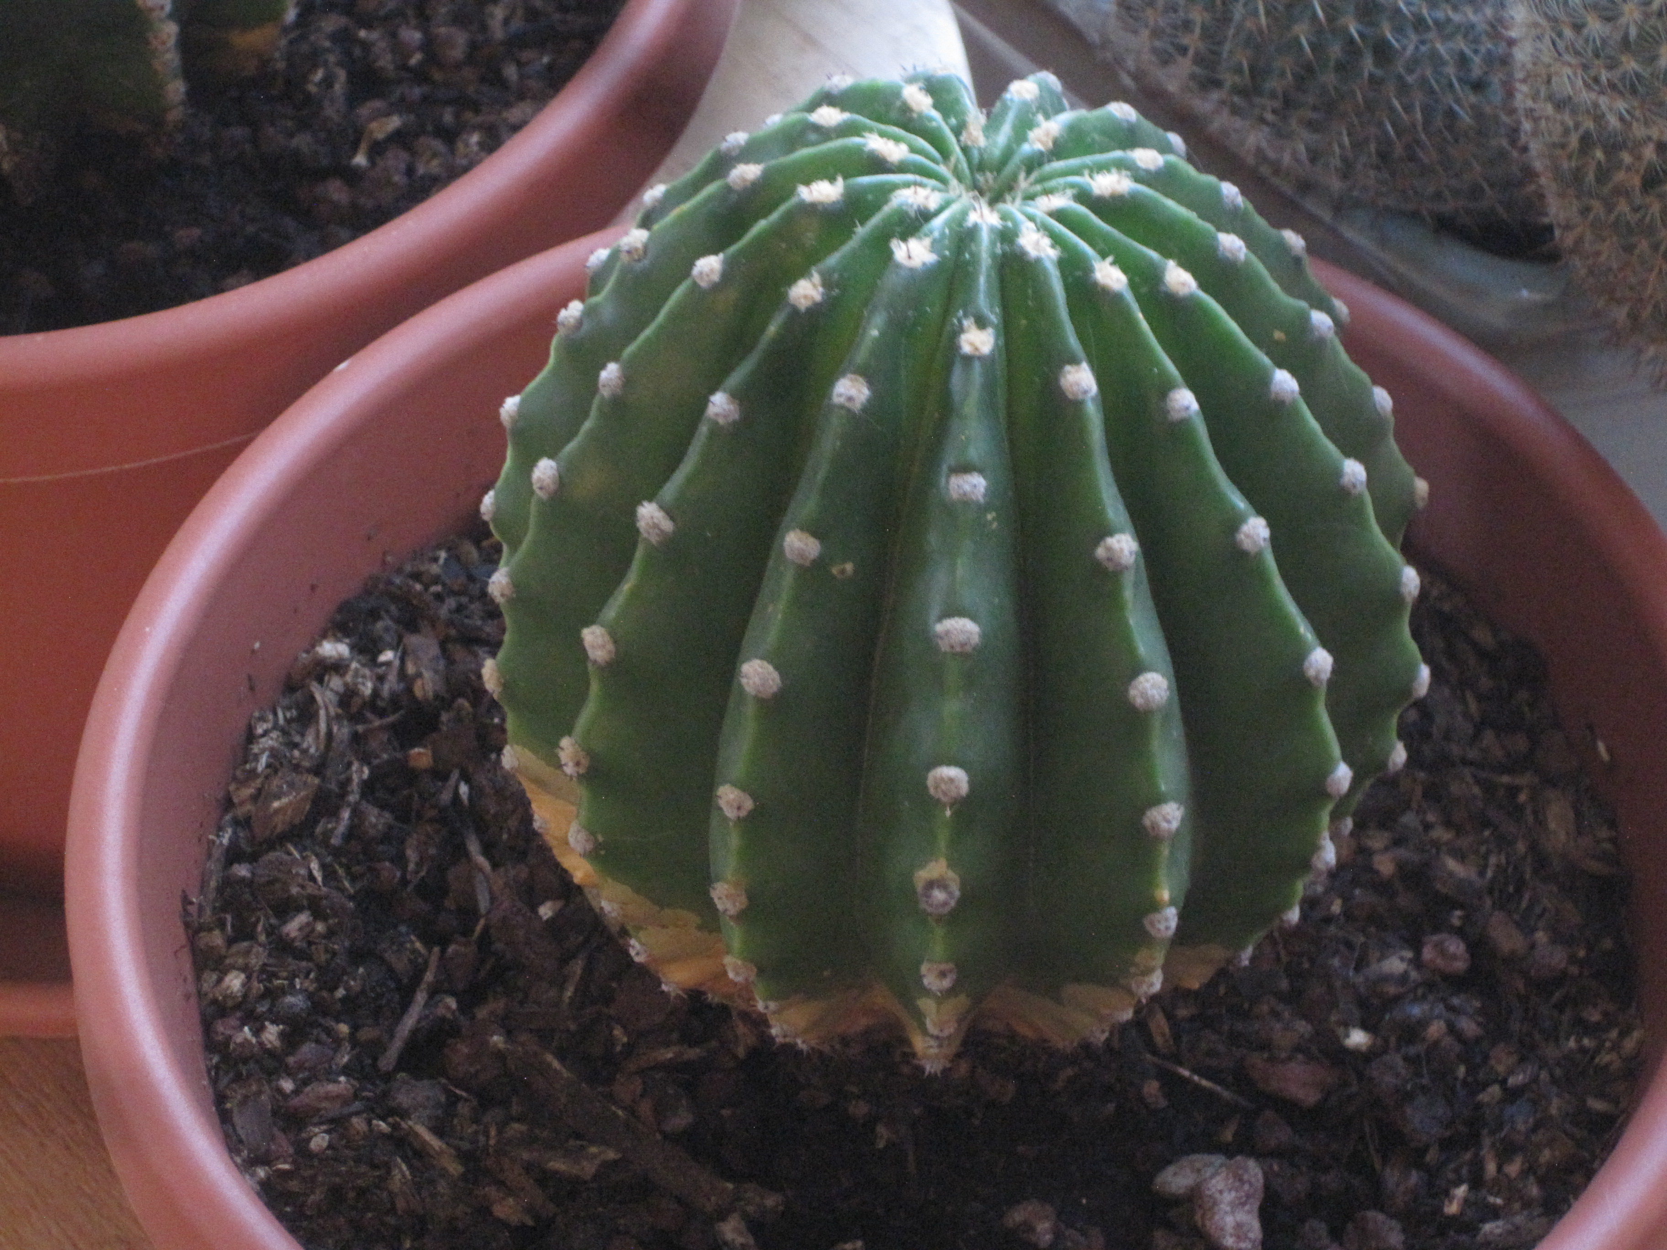
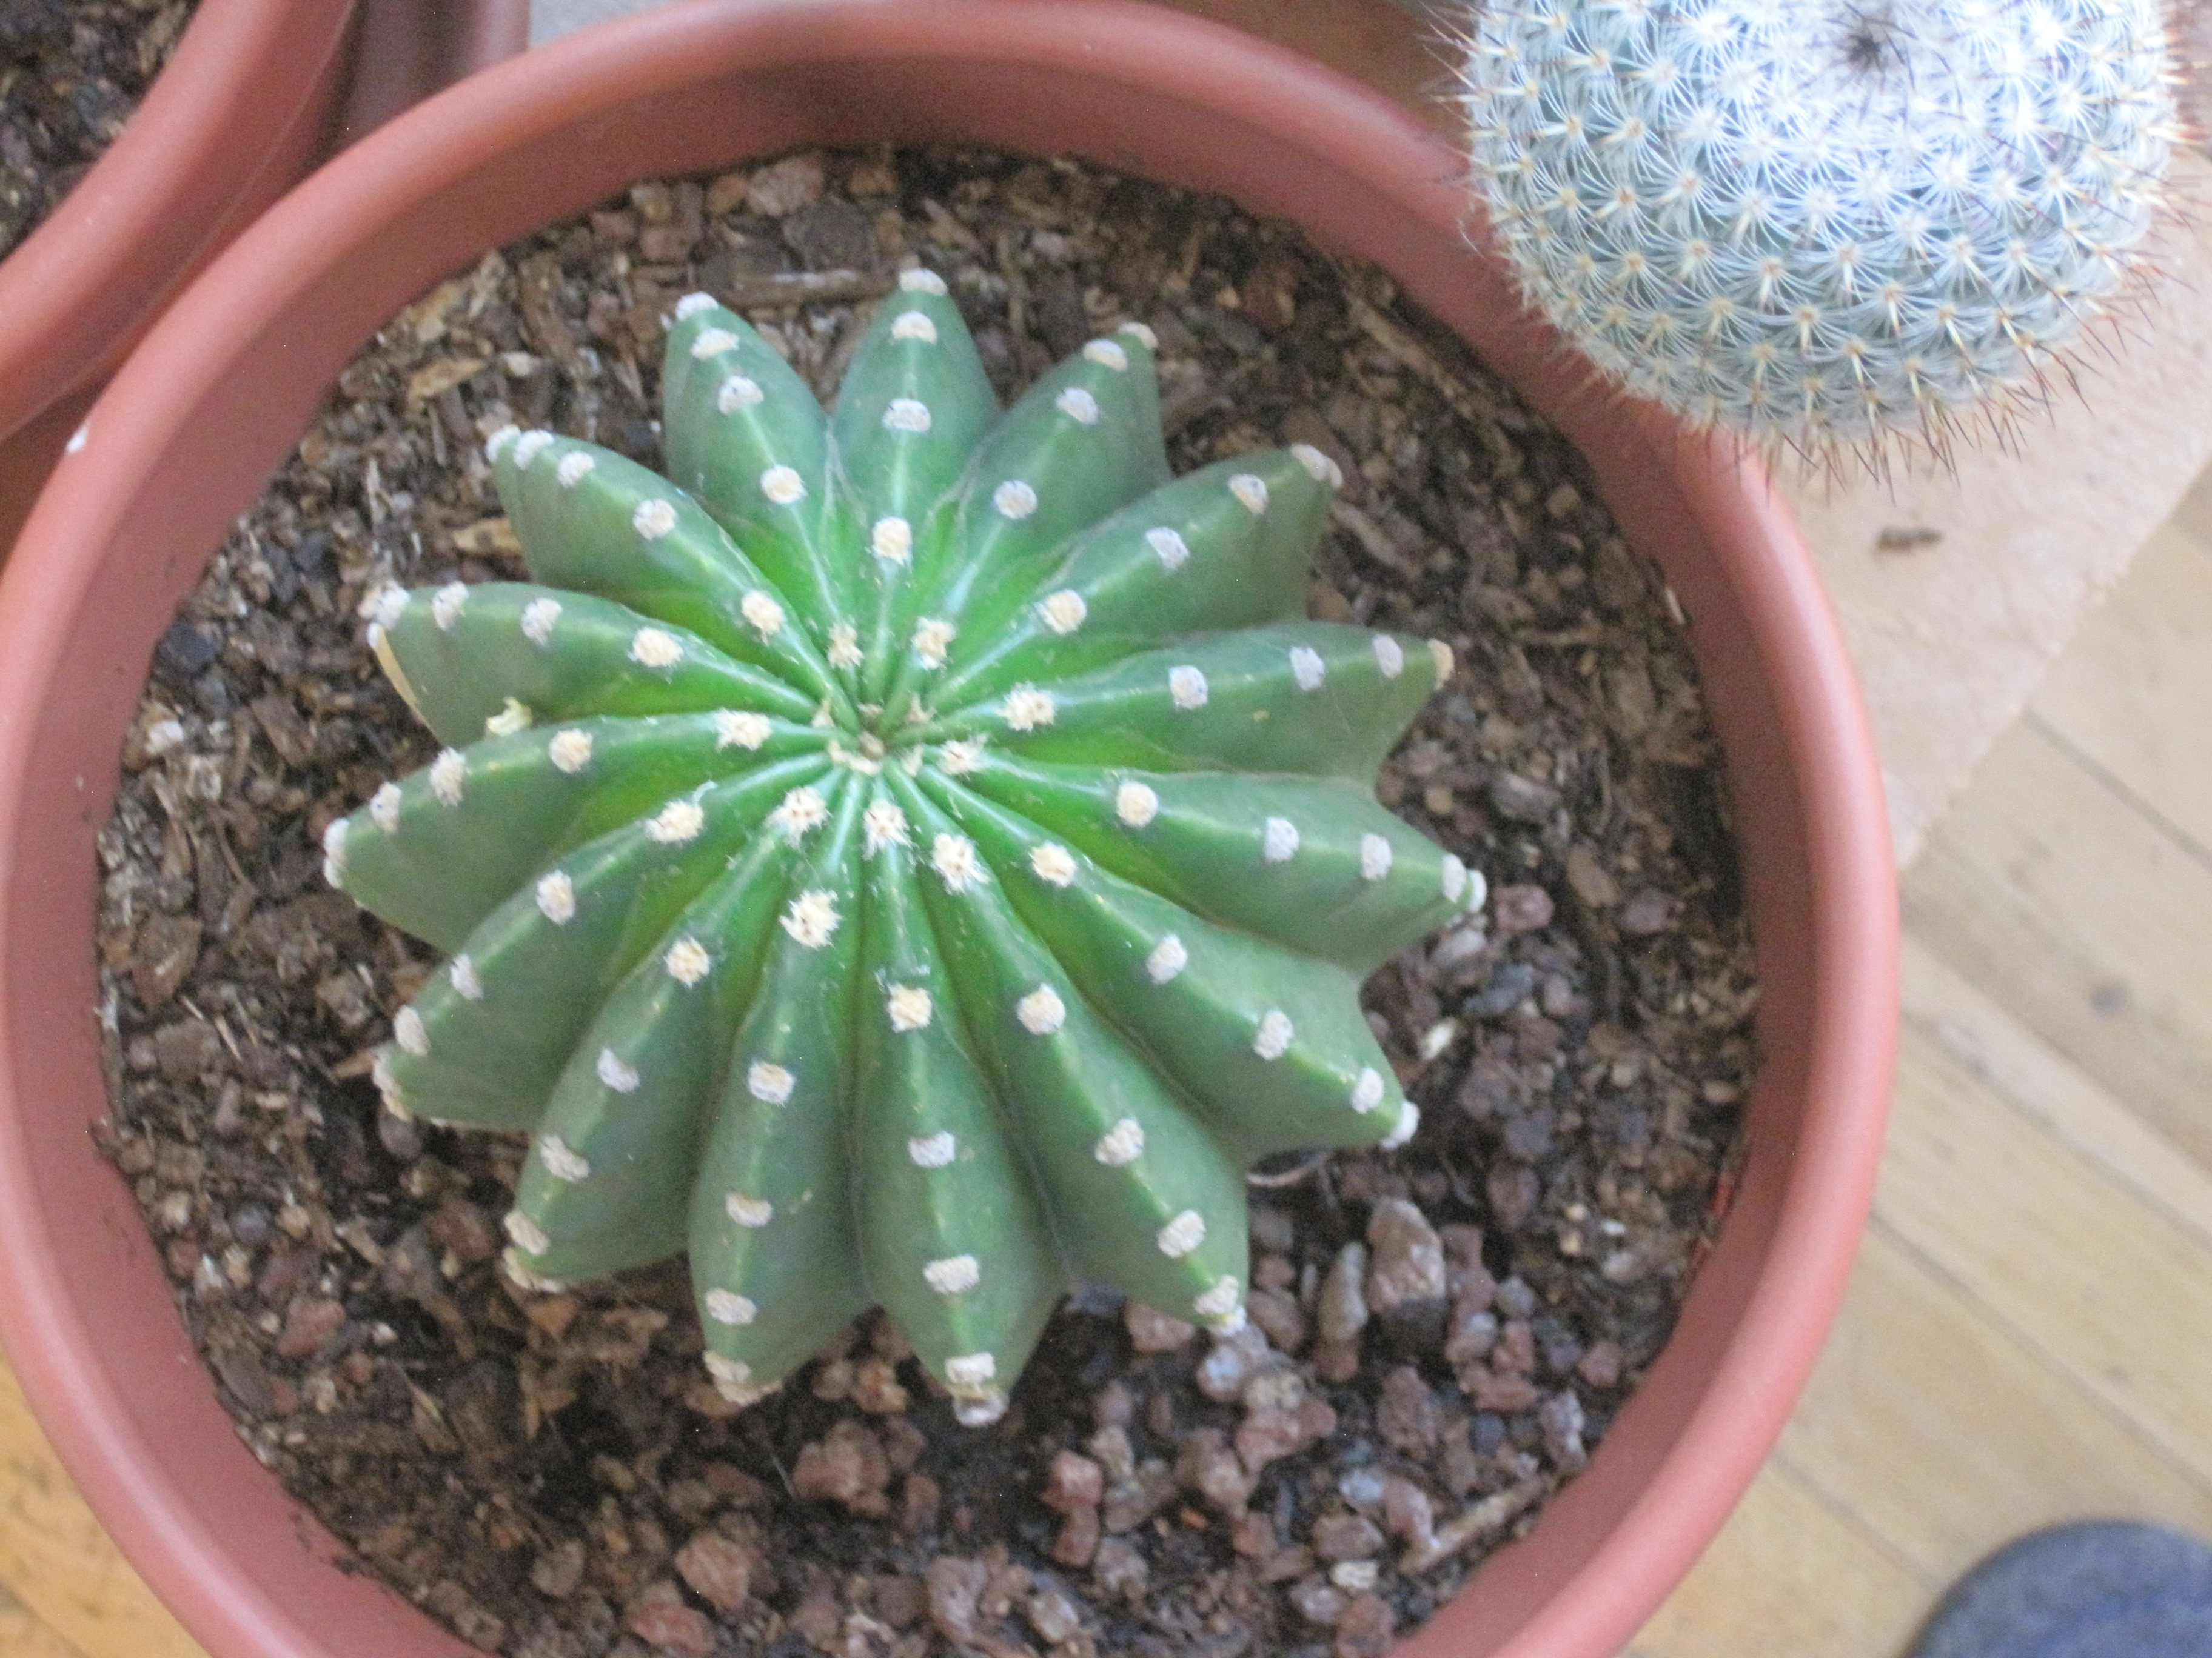
34
55

Slide 41
Part2:
Ratios
Golden Ratio

Slide 42
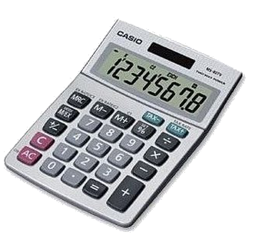
1 1 2 3 5 8 13 21 34 55 89 . . . .
Let’s take the ratio between adjacent pairs of Fibonacci numbers
next to each other
1/1 = 1
2/1 = 2
3/2 = 1.5
5/3 = 1.667
8/5 = 1.600
13/8 = 1.625
21/13 = 1.615
34/21 = 1.619
etc…
… so what do you think is the next number?

Slide 43
1 1 2 3 5 8 13 21 34 55 89 . . . .
Let’s take the ratio between adjacent pairs of Fibonacci numbers
next to each other
1/1 = 1
2/1 = 2
3/2 = 1.5
5/3 = 1.667
8/5 = 1.600
13/8 = 1.625
21/13 = 1.615
34/21 = 1.619
etc…
… so what do you think is the next number?

Slide 44
1 1 2 3 5 8 13 21 34 55 89 . . . .
Let’s take the ratio between adjacent pairs of Fibonacci numbers
next to each other
1/1 = 1
2/1 = 2
3/2 = 1.5
5/3 = 1.667
8/5 = 1.600
13/8 = 1.625
21/13 = 1.615
34/21 = 1.619
etc…
… so what do you think is the next number?

Slide 45
1 1 2 3 5 8 13 21 34 55 89 . . . .
Let’s take the ratio between adjacent pairs of Fibonacci numbers
next to each other
1/1 = 1
2/1 = 2
3/2 = 1.5
5/3 = 1.667
8/5 = 1.600
13/8 = 1.625
21/13 = 1.615
34/21 = 1.619
etc…
… so what do you think is the next number?

Slide 46
1 1 2 3 5 8 13 21 34 55 89 . . . .
Let’s take the ratio between adjacent pairs of Fibonacci numbers
next to each other
1/1 = 1
2/1 = 2
3/2 = 1.5
5/3 = 1.667
8/5 = 1.600
13/8 = 1.625
21/13 = 1.615
34/21 = 1.619
etc…
… so what do you think is the next number?

Slide 47
1 1 2 3 5 8 13 21 34 55 89 . . . .
Let’s take the ratio between adjacent pairs of Fibonacci numbers
next to each other
1/1 = 1
2/1 = 2
3/2 = 1.5
5/3 = 1.667
8/5 = 1.600
13/8 = 1.625
21/13 = 1.615
34/21 = 1.619
etc…
… so what do you think is the next number?

Slide 48
+

Slide 49
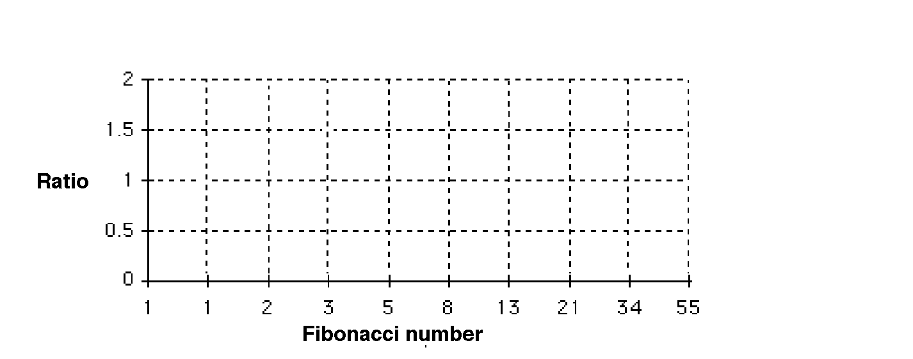
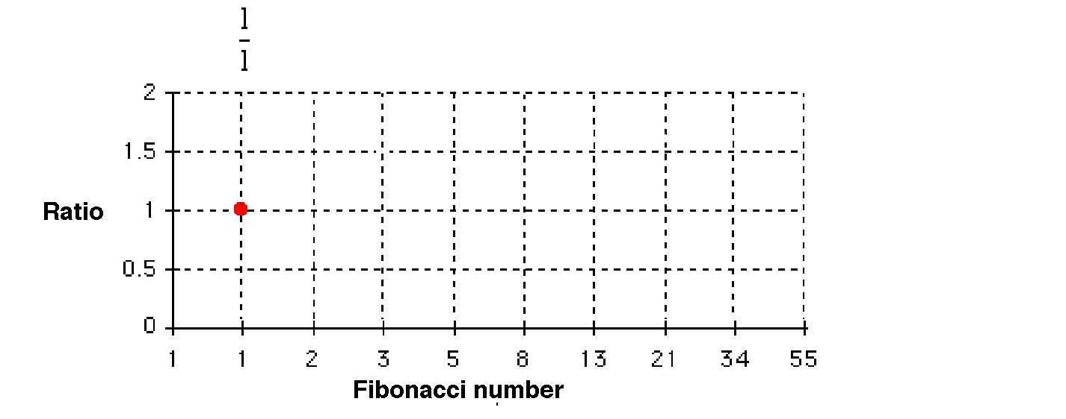

Slide 50
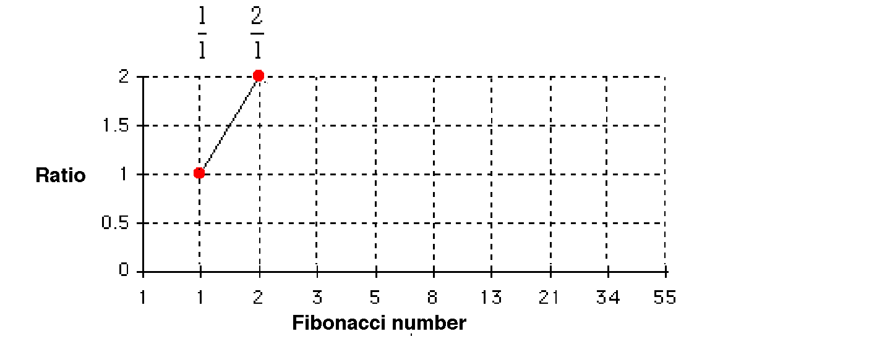

Slide 51
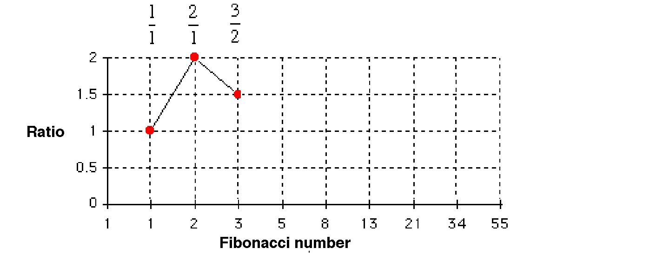
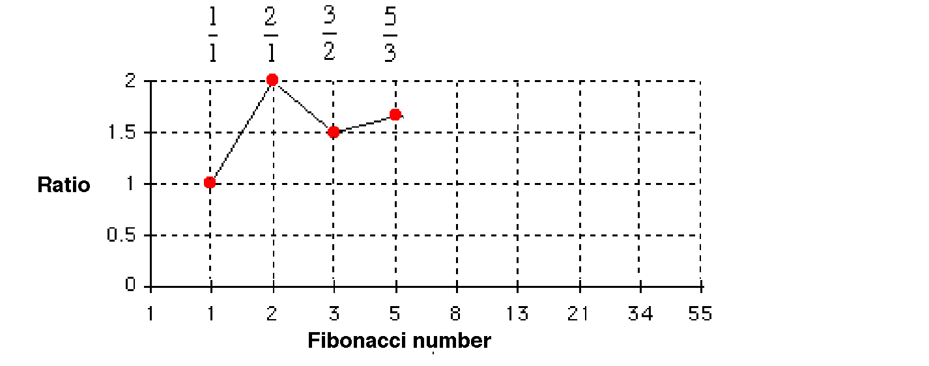

Slide 52
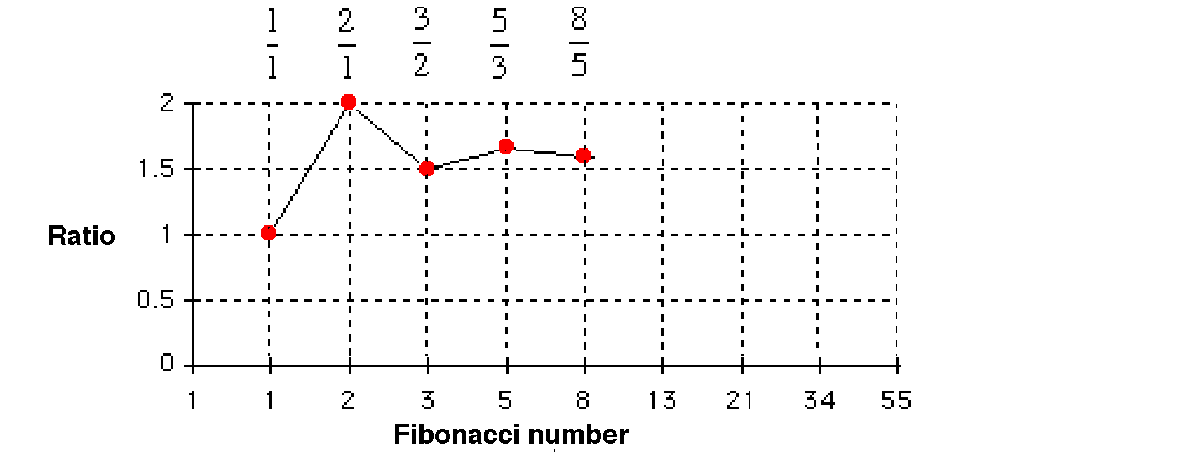
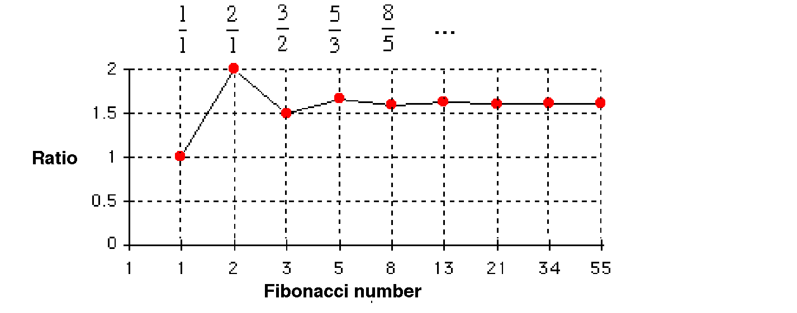
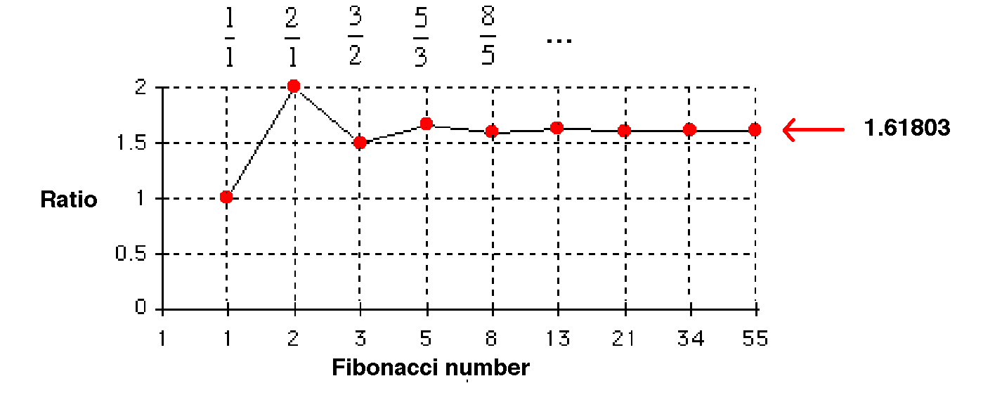
𝚽 (phi)

Slide 53
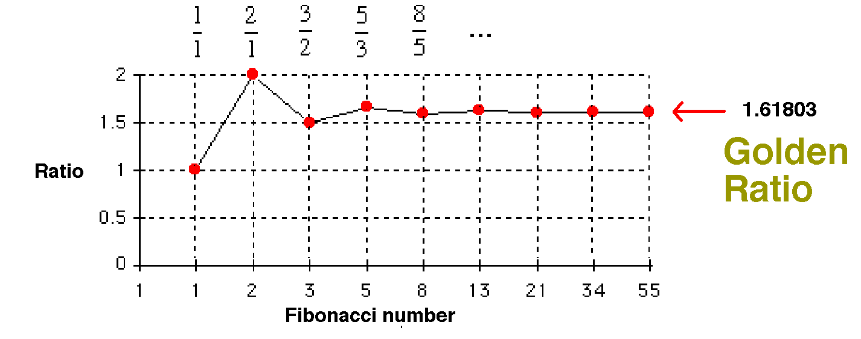
𝚽 (phi)
So why is this ratio interesting?

Slide 54
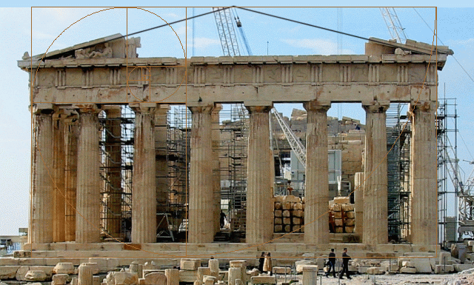
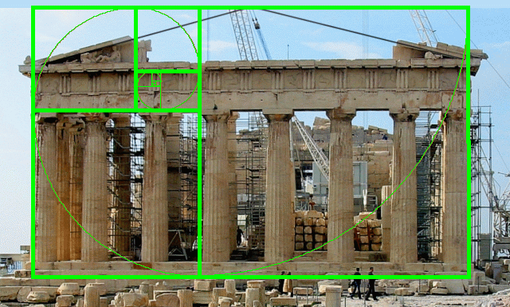
2000 years ago, The Greeks and
the Romans
used this ratio to design some of their buildings.
They believed that this ratio led to the most pleasing shapes
The width of this temple
divided by
the height of this temple
is equal to the Golden Ratio, 1.618

Slide 55
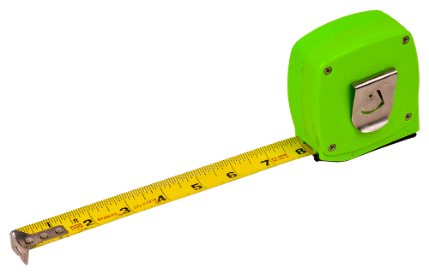
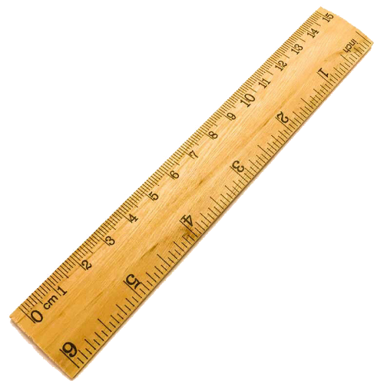
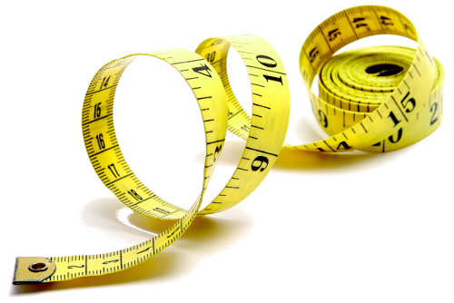
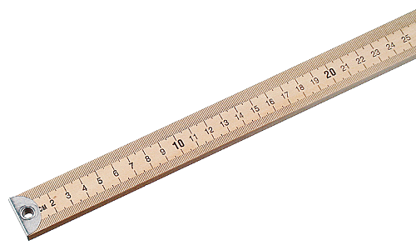
ACTIVITY!
Get out a ruler, a meter stick or a tape measure

Slide 56
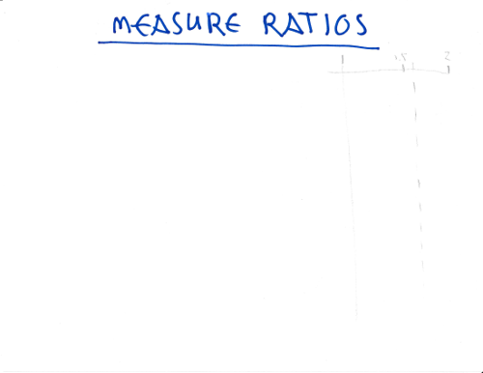
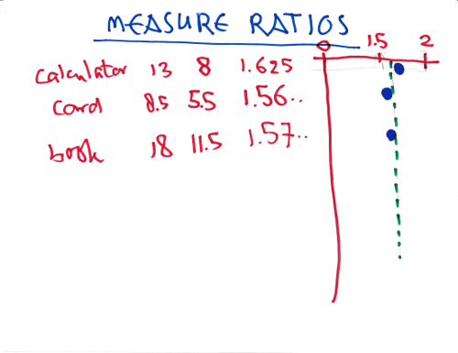
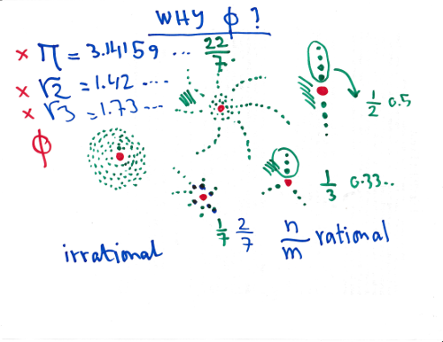
(switch to overhead camera)

Slide 57
Part 3:
Number systems

Slide 58
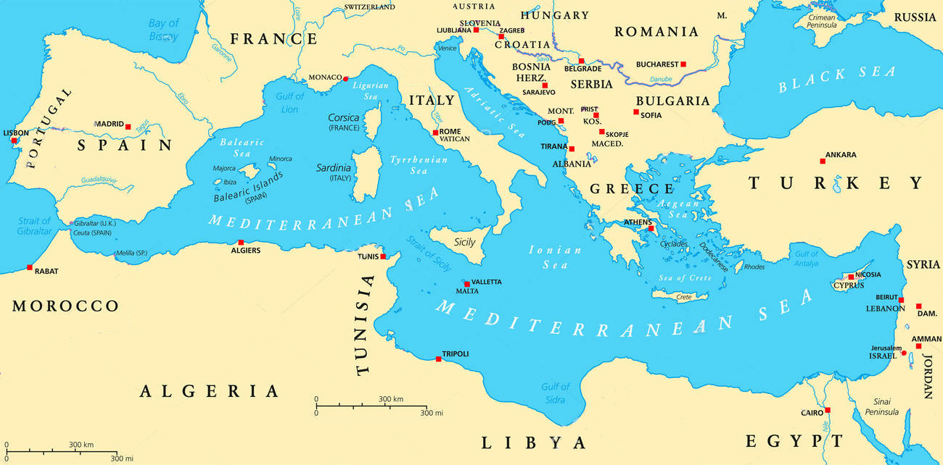
PISA
ALGIERS

Slide 59
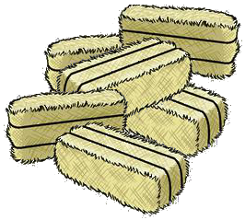
bottles of olive oil
sacks of grain
bales of hay

Slide 60
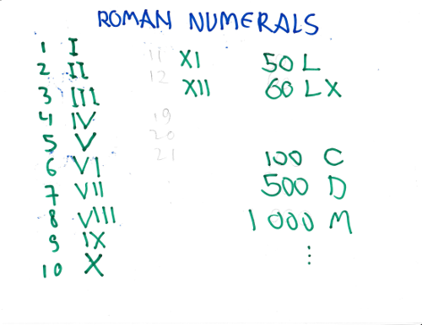

Slide 61
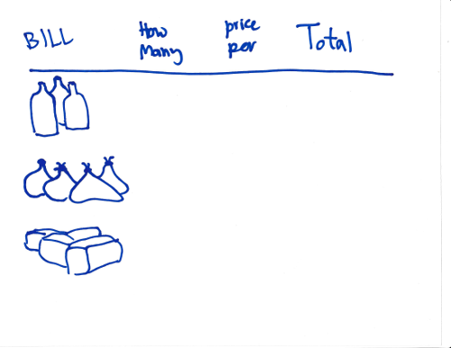
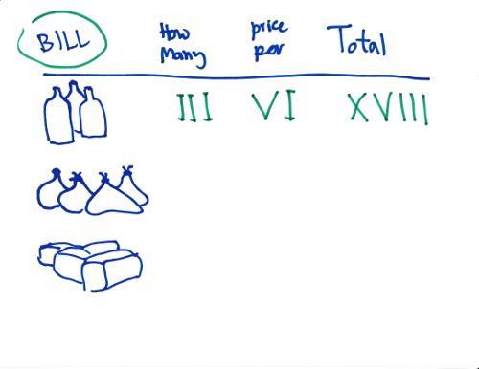
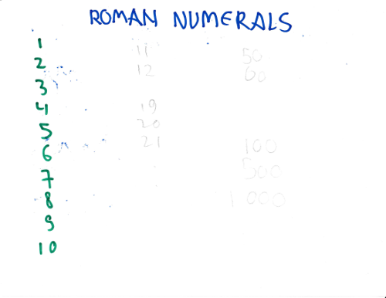
(switch to overhead camera)

Slide 62
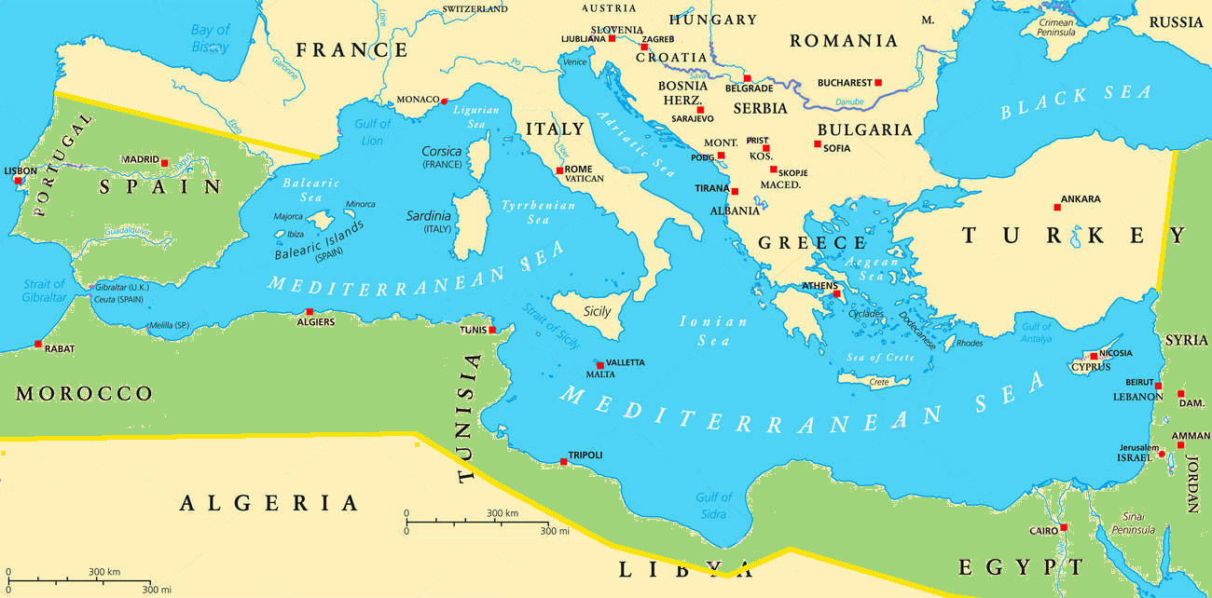
PISA
ALGIERS

Slide 63
PISA
ALGIERS

Slide 65
(switch to overhead camera)

Slide 71
(switch to overhead camera)

Slide 72
Where can you find Roman numerals?

Slide 73
Where can you find Roman numerals?

Slide 74
Where can you find Roman numerals?

Slide 75
Where can you find Roman numerals?
1000
1000
-100
50
10
5
3
--------
1968

Slide 76
Where can you find Roman numerals?
1000
1000
-100
50
10
5
3
--------
1968

Slide 77
MCMLXVIII
1968
11110110000
Roman
Arabic
Binary
𝚽 (phi)
= 1.61803…
1 1 2 3 5 8 13 21 34 55 …

